Slide 1
ERYTHROCYTE STUCTURE AND FUNCTION

Slide 2
Why is it called red blood cell ?
What is the shape of the RBC ?
What are the advantages of shape of the RBC ?
What are the factors that maintain the structure of the RBC ?
How does the RBC travel in minute capillaries ?
What are the functions of the RBC?

Slide 3
RBC structure
Average lifespan of a RBC is 120 days
Normal concentration is 3.9-6.5 × 10¹² /L
No nuclei, no organelles & with minimal amount of necessary enzymes
Average diameter is 7.2 µm (compared with 40um average cell )
Red color is due to heamoglobin (unstained RBS)
One RBC contains millions of heamoglobin molecules

Slide 4
RBC structure
Has characteristic biconcave discoid shape
  To increase the surface area (20-30% increase than a sphere of a same volume)
  Packing takes smaller space
  Maintained due to the cytoskeleton
  Changes shape during passage through smallest capillaries & reforms into biconcave structure again (compare RBC diameter 7.2 µm & smallest capillary diameter 3-4 µm)

Slide 5
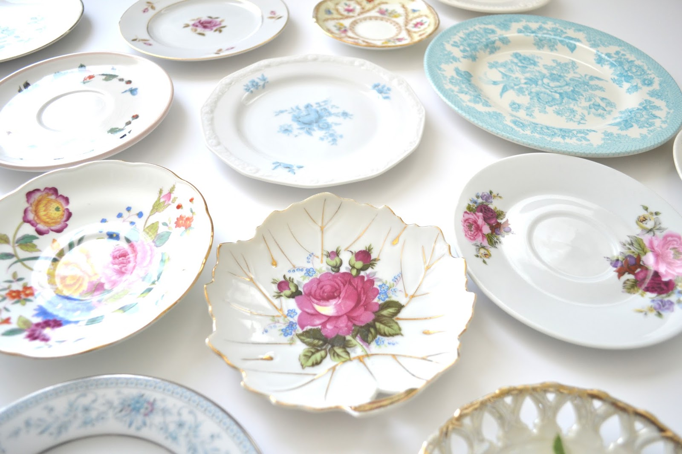
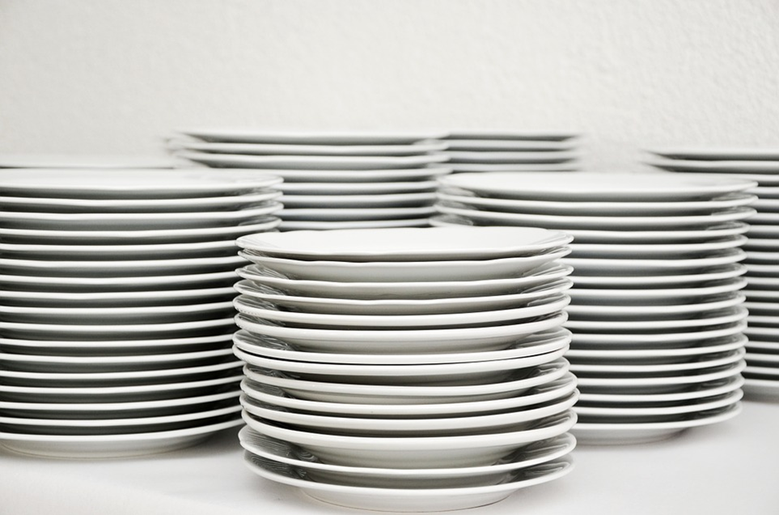

Slide 6
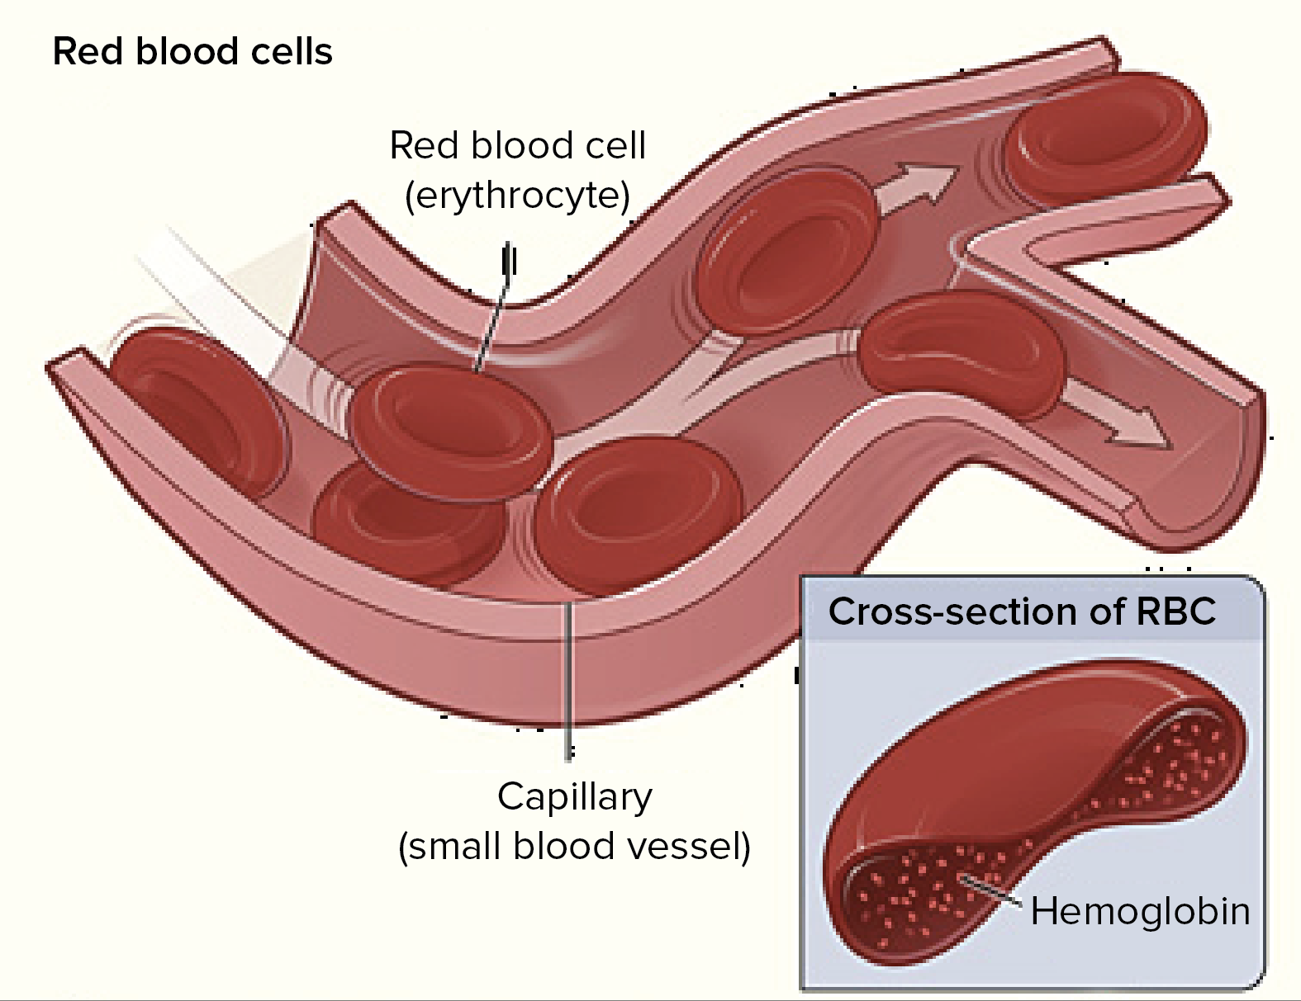

Slide 7
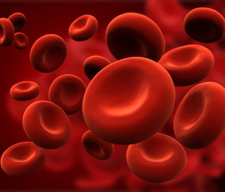

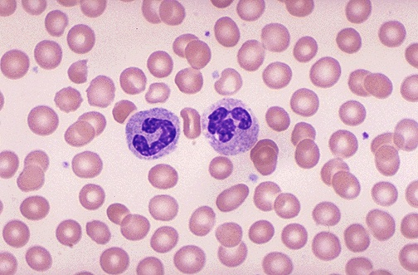
RBC structure

Slide 8
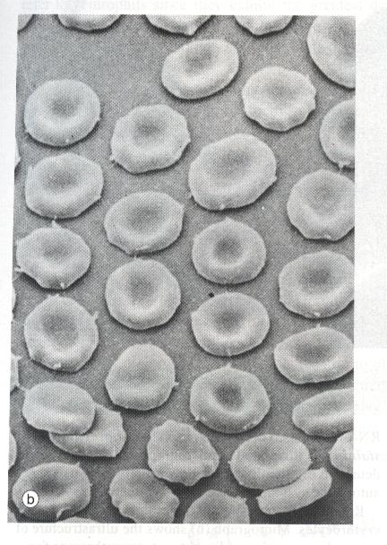
RBC structure

Slide 9
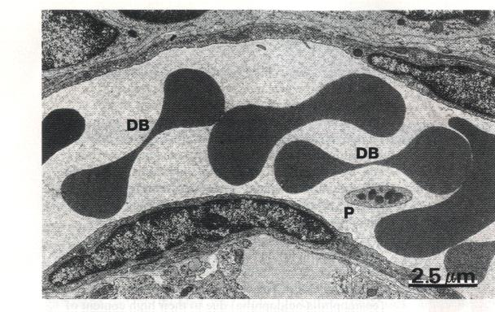
RBC structure

Slide 10
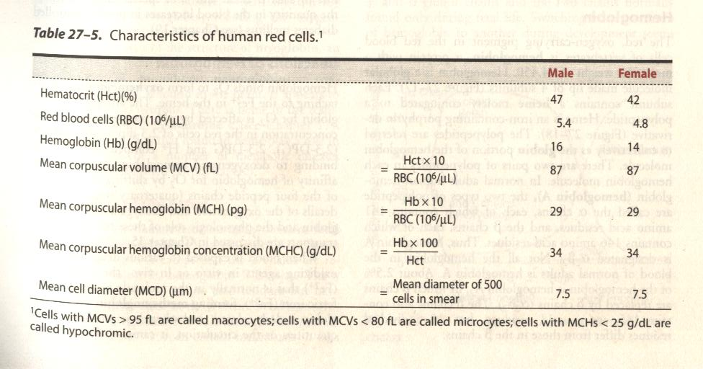
Characteristics of human RBC

Slide 11
RBC structure
RBC plasma membrane consists of lipid bilayer with globular proteins
Immediately beneath the plasma membrane is structure cytoskeleton
Cytoskeleton of the RBC
  Functions
    Maintains the cell shape
    Strengthen the cell membrane
    Permits flexibility

Slide 12
RBC structure
  Cytoskeleton of the RBC cont.
    Formed by protein molecules of the plasma membrane
      Integral proteins (penetrates the lipid bilayer)
        Band 3 proteins
        Glycophorins
      Peripheral proteins (loosely attached to the lipid bilayer)
        Spectrin
        Ankyrin
        Band 4.1 protein
        Actin

Slide 13
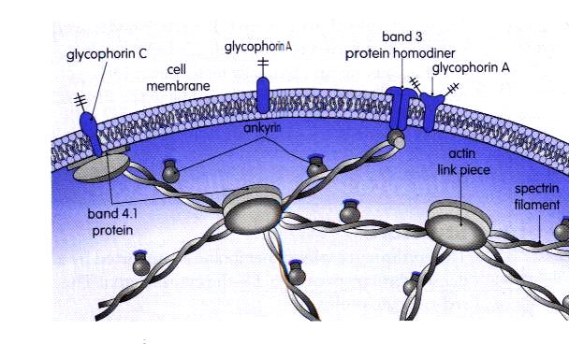
Cytoskeleton of the RBC

Slide 14
RBC structure
Cytoskeleton of the RBC in diseases (Hereditary spherocytosis)
  Autosomal dominant inheritance (AD)
  Deficiency or dysfunction of the skeletal protein (Spectrin) of RBC membrane
  Spherical RBC
  Less deformable cells gets destroyed in spleen & liver
  Haemolytic anaemia

Slide 15
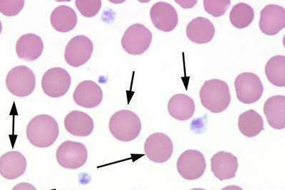

Slide 16
Functions of RBC
Gas exchange & transport
  O₂
  CO₂
Electrolyte balance

Slide 17
Functions of RBC
Gas exchange & transport
  Resting requirement of O₂ is 250 ml/min
  But 1000 ml/min of O₂ is delivered to the body
  O₂ is mainly transported binding to the haemoglobin
  Small amount is transported as dissolved O₂

Slide 18
Functions of RBC
Gas exchange & transport cont.
  O₂ content of blood depend on
    Concentration of haemoglobin
    Affinity of haemoglobin for O₂
    Solubility of O₂ in blood (small effect)
  CO₂ transport in blood
    90% as bicarbonate (important in pH buffer of blood)
    5% as carbamino groups (amino groups of Hb & protein)
    5% as dissolved in blood

Slide 19
Functions of RBC
Electrolyte balance
  Potassium, hydrogen & chloride ions are actively transported across the plasma membrane of RBC (involve in homeostasis of above irons)
    High extracellular potassium levels in stored blood
    Hyperkalaemia is treated with insulin & glucose

Slide 20
SUMMARY
Structure of RBC
  Size & shape of RBC
  RBC membrane
RBC function

